Slide 1

Module 3.2
Project Settings

Slide 2
Project settings
Notes:
This page intentionally blank

Slide 3
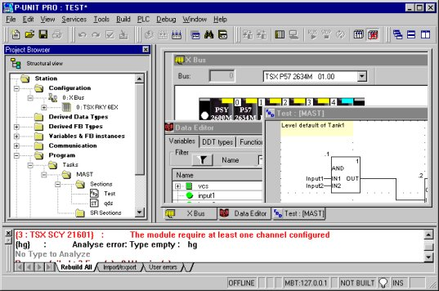
User interface
The user interface is composed of several, configurable windows and toolbars.
Menus & Toolbars
Configuration
Application
Browser
Data Editor
Language editor
Output windows
Status bar
Notes:
Toolbars
All functions can be accessed using the menu bar. The most frequently used functions can also be accessed directly using an icon in the Standard toolbar. Otherwise, you can define your own toolbars to fit your personal needs.
Project browser
The project browser allows you to display the contents of a Unit Pro project and to move around its various elements.
Configuration editor
The configuration editor is used to configure the hardware and parametrize each module.
Language editor
Comply with standard IEC 1131-3, the langage editor allows to program in
- Ladder
- Function Block Diagram
- Sequential Flow Chart
- Structured Text
- Instruction List

Slide 4
See comments
Notes:
Data editor
The data editor guides the user through the general features available in the data editor in order to :
- create data types,
- instantiate data types,
- search for data types or instances
Output windows
The output window provides information about errors which have occurred, signal tracking, import functions, etc.
Status bar
The status bar gives a variety of information linked to the operation of the software :
- Off/Online
- Driver
...

Slide 5
User interface (cont)
Toolbars
  All functions can be accessed using the menu bar. The most frequently used functions can also be accessed directly using an icon in the Standard toolbar. Otherwise, you can define your own toolbars to fit your personal needs.

Slide 6
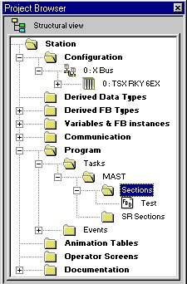
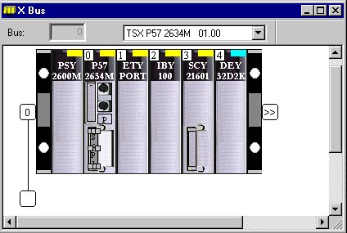
User interface (cont)
Project browser
  The project browser allows you to display the contents of a Unit Pro project and to move around its various elements.
Configuration editor
  The configuration editor is used to configure the hardware and parametrize each module

Slide 7
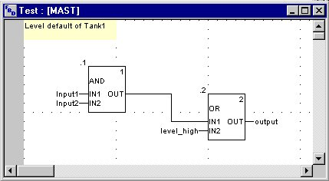
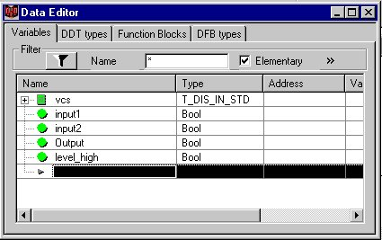
User interface (cont)
Language editor
  Comply with standard IEC 1131-3, the langage editor allows to program in :
      Ladder
      Function Block Diagram
      Sequential Flow Chart
      Structured Text
      Instruction List
Data editor
  The data editor guides the user through the general features available in the data editor in order to :
      create data types,
      instantiate data types,
      search for data types or instances

Slide 8
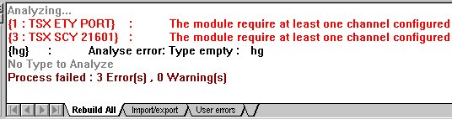
User interface (cont)
Output windows
  The output window provides information about errors which have occurred,
  signal tracking, import functions, etc.
Status bar
  The status bar gives a variety of information linked
  to the operation of the software :
      Off/Online
      Driver..

Slide 9
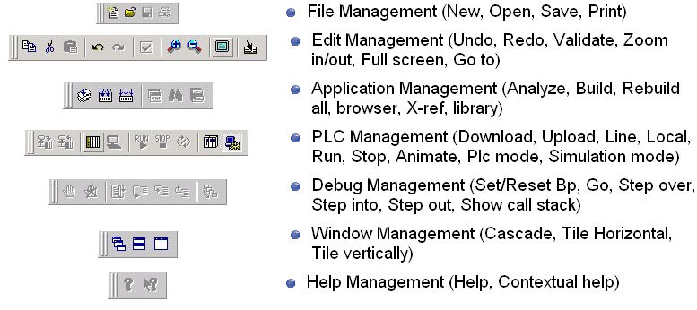
Common toolbars

Slide 10
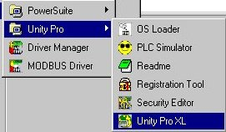

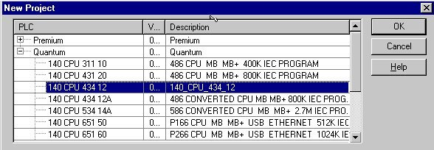
Start a new project
Select Unity Pro in program group Schneider Electric
Select a new project by the icon
Select a PLC CPU and click "Ok"

Slide 11
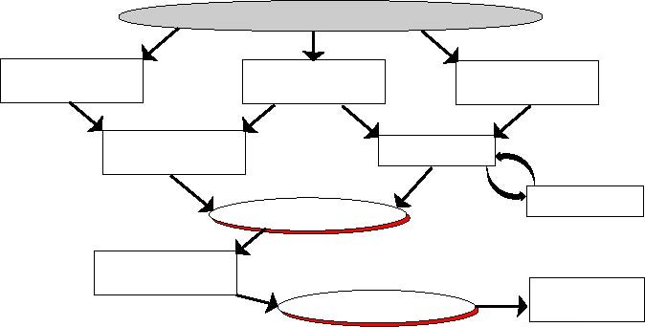
Application Development
Terminal & Project settings
Hardware
configuration
Data structuration
& symbolisation
Application
structuration
Data - channel
associationarial
Programming
Analyse
Code generation
Select a target
& download
Operator Screens
Debugging

Slide 12
Options
Work station settings, accessible via the command Tools => Options
General tab defines :
  Unity Pro (project version, upload and errors)
  the work directories of Unity Pro (by default)
Data & Languages tab contains settings for entering data
Connection tab contains the options relating to the connection of the terminal to the PLC
Library settings tab gives information about library (version, location)
Operator screens tab is used to :
  Define the workspace and the screen size
  Enable the modifications in online mode

Slide 13
See comments

Slide 14
See comments

Slide 15
Project settings
Project settings only , accessible via the command Tools => Project Settings
Note : These settings are saved in the application
Build tab configures the generation of the project (analyse, code generation, diagnostic,…)
Editors tab defines the features of ladder editor
Language extensions tab contains settings for enabling expansions to IEC 61131-3 (data type, programming language, structure) for an application IEC compliant, uncheck all check boxes in this register tab
Operator screens tab allows :
  the management of screen by the operator
  the detection by the PLC of the last displayed screens

Slide 16
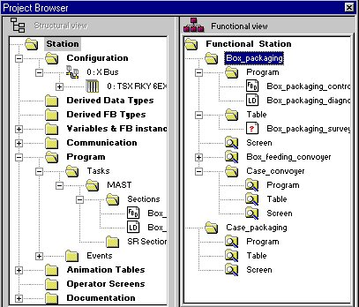
Project browser
Presents the contents of the project in tree-structured format and allows to move around its various elements: configuration, data, program, etc.
Displays in 2 different ways :
  Structural View
  Functional View
Brings the components of the application (Sections) to the fore rather than the tools used
Enables the user to structure the application into functional subassemblies

Slide 17
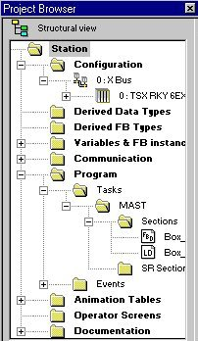
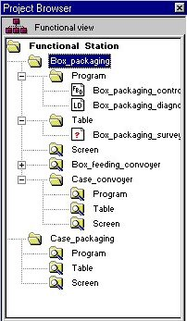

Navigation between views
    Structural View
    Functional View
    Views Vertical
    Views Horizontal

Slide 18
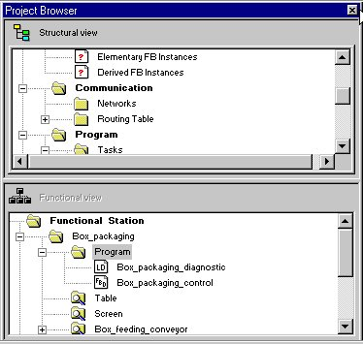
Navigation between views (cont)
    Structural View
    Functional View
    Views Vertical
    Views Horizontal

Slide 19
Structural view
Station : access the structure of the project and the associated utilities
Configuration : access and manage the hardware configuration
Derived Data Type :access and manage the type of structured variables (array and DDT types)
Derived FB Type : access and manage the DFB types
Variables & FB instances : access and manage all variables and function block instances
Communication :access and manage the configuration of the networks (only) : Ethernet, Fipway, Modbus Plus and routing table

Slide 20
Structural view (cont'd)
Program :define and manage the structure of the program (tasks, sections, events, ...) and access the language editors of the program elements (sections, Sub routines)
Animation Tables : monitor and manage the user variables
Operator Screens : access and manage the runtime screens for application monitoring
Documentation : access, define and build the documentation file for the project

Slide 21
Project properties
Access to the project properties by right-clicking on the station folder
General tab : define the name of the project (Station or Fucdntional Station by default)
Protection tab : activate the protection of the program sections
  Possible to change the password or clear it
Note: The protection can not be activated if there is no password
Identification tab : identify the project
  current version with the option of automatic incrementation
  creation and generation date
Comment tab : Associate a comment to the project

Slide 22
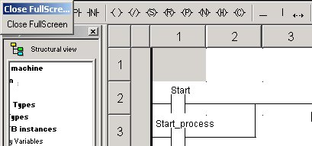
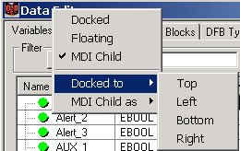
Ergonomics
All editor can be switched from the normal mode to the full screen mode
  Enlarge the space dedicated for edition
  Dockable and floating windows kept to drag and drop
Some windows (like animation tables, data editor) can be docked or floating :
  Docked : to anchor in certain positions outside of the application window (like the project browser)
  Floating : To be always visible in foreground

